Slide 1


Team Name: Galaxy
Team Leader name: R Sugesh
Team Name :
Team Leader Name:
Team Members: (Count & Names)

Slide 2

Brief Summary of Project
Which theme do you choose from the problem statement?
Theme 2 was chosen and a dashboard was created that shows all profits and losses, including the necessary details from the problem statements.
The interest rate, investment details, and top performers will be explained in this dashboard.
This would be easy to analysis and improve the work profits

Slide 3
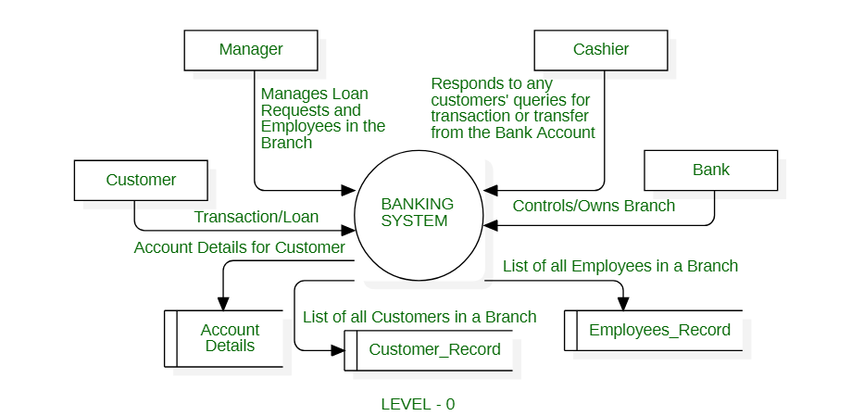
High level design diagram Solution approach

Slide 4
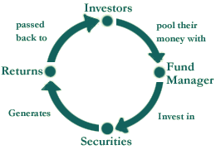
Solution approach
To analyze the dataset, the initial approach is to visualize it using Necessary tools and create charts that are easy and understandable.
I used all the data sets given. Based on the data set, I ordered the top performers.
These fig shows the working of investments platform

Slide 5
REQIUREMENTS
Cost: it's free and open source ,if premium templates that are needed mean price may vary
Time : it will take 5-6 hours approximately
Resources : data sets that are given already.
Tools : Power BI, Excel

Slide 6
Source Code
All the important calculations and codes that are written in the ReadMe.txt file these are in the hackathon folder

Slide 7
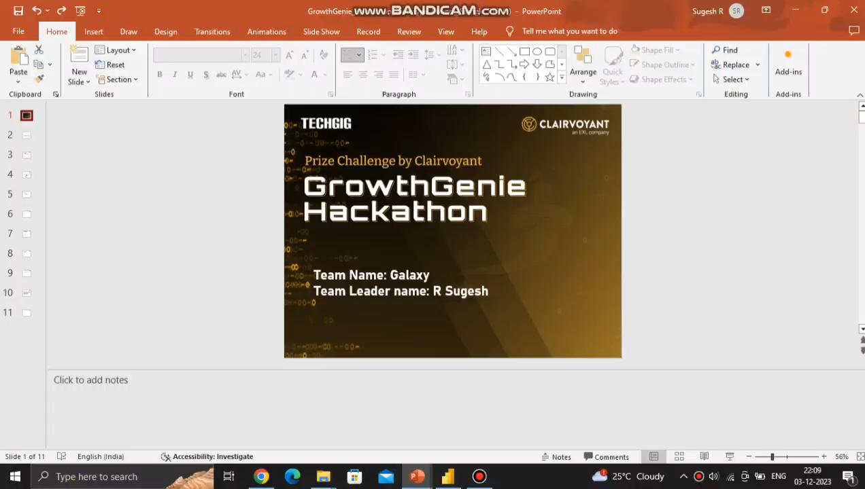
Video showing the demo functionalities and working prototype

Slide 8
Why was specific theme chosen (optional)
Actually I am interested in the data analytics and data visualization topics so I prefer the theme 2. so I think theme 2 would be easy to me

Slide 9
Brief snippet of team
Actually I am the leader of the team. I am BTech IT graduate and I have a skills in python, data analytics, Django, SQL and I am very much interested to learn AI.

Slide 10
Additional Points
You need to utilize Power Bi software in order to see the PBIX file that I submitted.
I actually uploaded a power bi file with a PDF, but the PDF did not display all of the contents.
Use the power BI file for evaluation as a result.
I Mentioned the link below to access the software it is free and Open Source. It will be available on Microsoft Store
https://www.microsoft.com/store/productId/9NTXR16HNW1T?ocid=pdpshare

Slide 11
Thank You !!!

